Slide 1
Train Ticket Reservation
CSE 207, Data Structure.

Slide 2
Objectives:
Introduction.
Problem.
Proposed solution.
Software description and facilities.
Goals of this software.

Slide 3
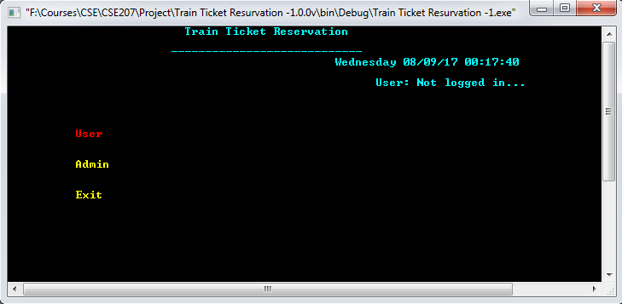
Project Ideas and Layouts
Using Interface – (windows console)

Slide 4
Project Ideas and Layouts
User
Login
Registration
Admin
Add A New Train
Edit Time Table & Seats
Exit
Terminate Program
Back To main Menu
Buy Tickets
Check Own Tickets
Account Info
Logout
New User Registration
Check Schedule
Add New User
Logout

Slide 5
Project Ideas and Layouts
Train Time Table
Using Queue To Store Train Information.
Using Stack To Display Train Information.
Train Ticket Buy
Using Queue To Display Train Information.
Using Queue To Store Train Information.
User Login Authenticate
Using Dynamic List [Vector] To Authenticate.
User Information
Using Queue To Preloads All Data From File.

Slide 6
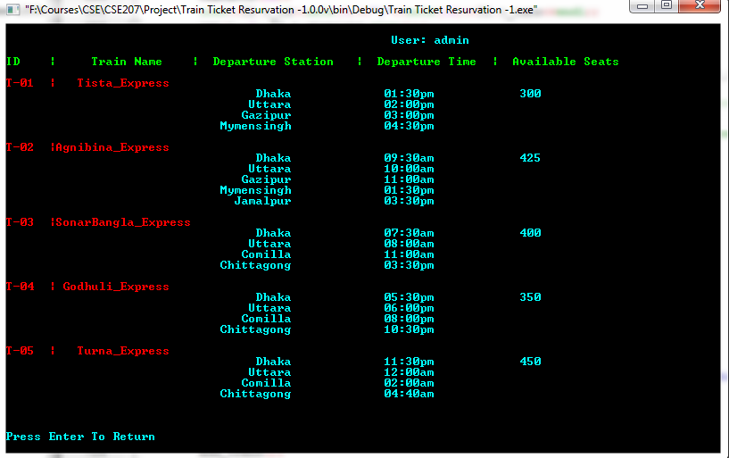
Project Ideas and Layouts
Train Information

Slide 7
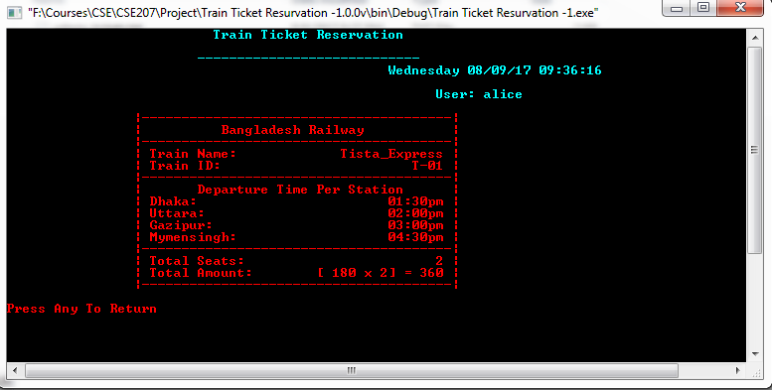
Project Ideas and Layouts
Ticket Output

Slide 8
Demonstration Part

